Slide 1
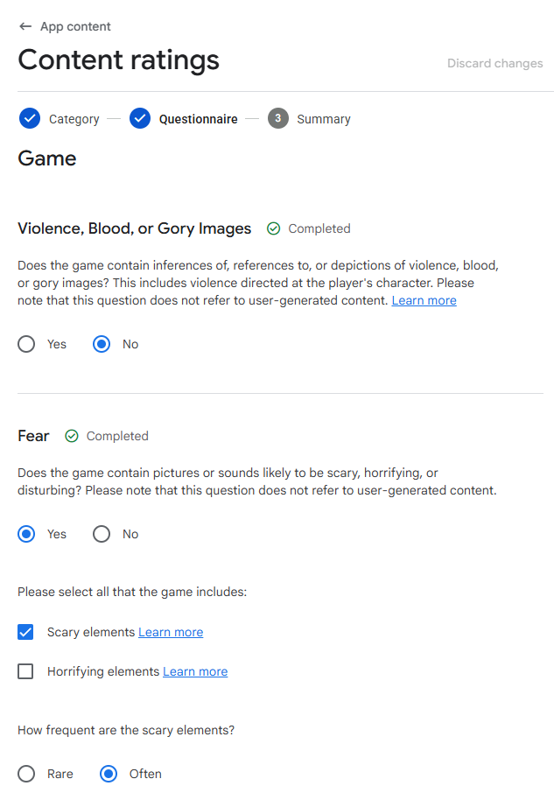
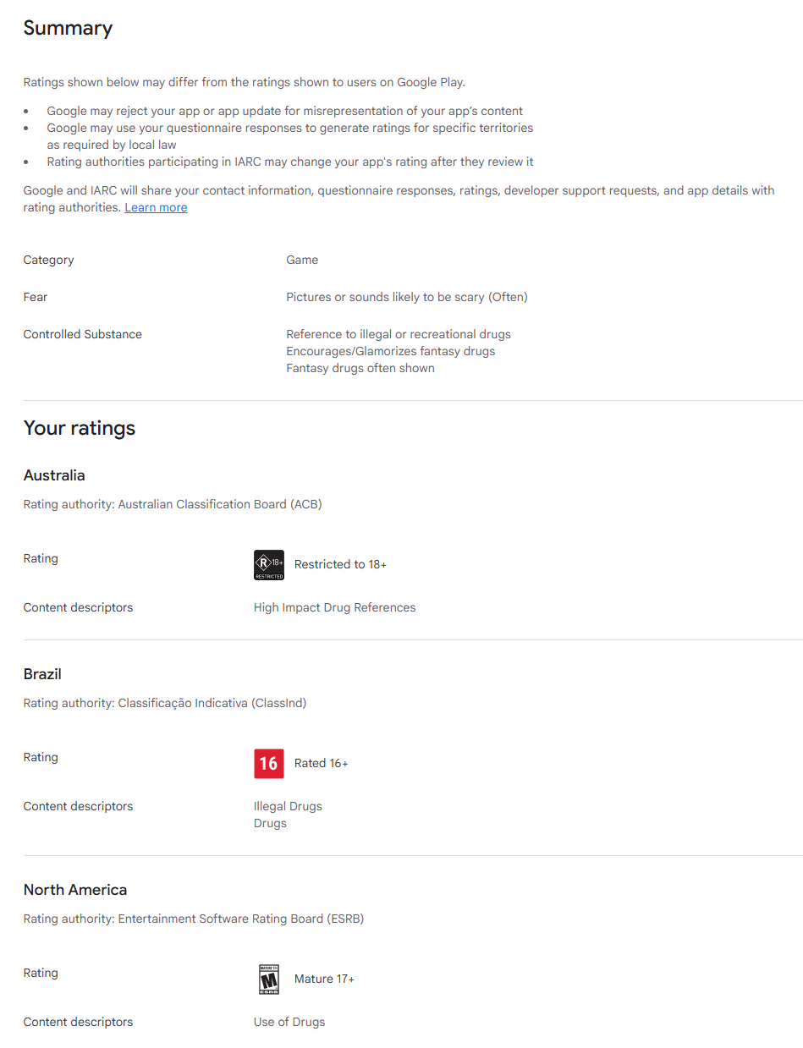
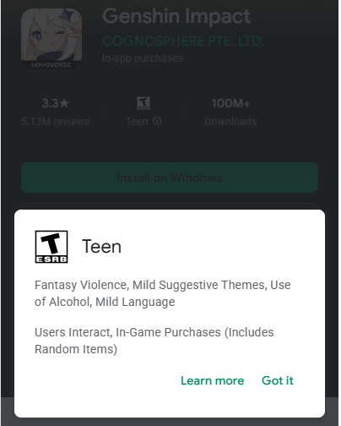
Black-Box Reverse Modeling and Prediction of Google Play Age Rating Questionnaire
Description:
Google Play’s age rating mechanism aims to help parents select appropriate applications for minors. In the Google Play store, users can see each app’s age rating, Content Descriptors, and Interactive Elements. These rating results are generated after developers complete content rating questionnaires. However, the entire rating process is opaque to both developers and users. Google does not disclose the specific decision rules or logic of the questionnaire, making the process a complete black box.
This project aims to reverse model this black-box system using a data-driven approach. By exploring the mapping relationship between questionnaire answers and the final age rating, the experiment seeks to accurately predict the age rating based on the questionnaire responses.
Content rating questionnaire
Content rating questionnaire result page
Age rating display in Google Play Store

Slide 2
Black-Box Reverse Modeling and Prediction of Google Play Age Rating Questionnaire
Task:
1）Data Collection Strategy Design and Implementation:
Design a systematic and efficient strategy for the tree-structured questionnaire and implement automated submission and data collection via scripts. Collect at least 1000 valid samples with sufficient diversity.
*Google Play Developer Console:https://play.google.com/console/developers
(Access requires a registered Google Play Developer account.)
2) Model Training and Prediction:
Perform feature engineering on the collected data and train machine learning models for multi-class age rating prediction. Attempt at least 3 different models and conduct performance comparison and optimization.

Slide 3
Black-Box Reverse Modeling and Prediction of Google Play Age Rating Questionnaire
3) Result Analysis:
Perform a comprehensive analysis of the experimental results, including overall model performance, differences across age rating categories, exploration of potential patterns in Google Play’s rating mechanism (e.g., most influential questions), and overall conclusions.
4) Report:
Write a complete report covering: data collection strategy and dataset analysis, model training and performance evaluation, problems encountered and solutions, result analysis and major findings. The report must include dataset information, core code, and key result charts.

